Slide 1
Workflow vs AI Agent Design
Understanding Fixed Processes vs Intelligent Systems

Slide 2
Process Chosen:
Handling Customer Support Queries in a SaaS System
Goal:
Classify user queries
Provide appropriate response or route to correct team

Slide 3







Step -1
01
Step - 4
04
Receive Query
Send response
Workflow Process
Stages
Step - 2
02
Characteristics
Classify query using predefined rules
Predictable
Rule-based
No decision-making flexibility
Step - 3
03
Route to correct team (billing / tech / sales)

Slide 4









Workflow Diagram
Five steps ensure structured yet flexible project flow
User Query
Classification Rules
Category
Assigned Team
Response
The process begins when a customer submits a question or issue through a support channel (e.g., email, chat, or form).
The system applies predefined rules or keywords to analyze the query and determine its type (e.g., billing, technical, sales).
Based on the rules, the query is assigned to a specific category that defines the nature of the issue.
The categorized query is routed to the appropriate team (e.g., billing team, technical support, sales team) responsible for handling it.
The assigned team reviews the query and provides a response or resolution back to the user.
01
02
03
04
05

Slide 5





Agent Behavior - 2
Agent Behavior - 1
02
Decide which tool or action to use
01
Understand user query using LLM
Transparency - 3
03
Dynamically route or respond
Agent Approach (AI Agent)
Example:
“Based on the query, I will classify this as a billing issue and retrieve relevant policy before responding.”

Slide 6



Agent Diagram
5
Tool Selection
The agent decides which tool or resource is needed
Five repeating steps drive ongoing development success
1
User Query
4
Action
The user submits a question or request to the system
The selected tool is used to perform the required task
2
LLM (Reasoning)
3
Response
The model analyzes the query and understands the intent
The final answer or result is generated and returned to the user

Slide 7
Key differences
Aspect | Workflow | Agent
Structure | Fixed | Dynamic
Decision Making | Rule-based | LLM-based
Flexibility | Low | High
Adaptability | Limited | Strong

Slide 8






ReAct Framework (from learning material)
Agents use ReAct (Reason + Act):
Reason → Understand problem
Act → Use tools or take actions
Example:
Reason: “This is a billing issue”
Act: “Fetch billing data → generate response”
03
When to Use Workflow
Use workflows when:
02
No ambiguity
01
Examples
Logic is simple
Form processing
Data pipelines
Scheduled tasks
Steps are predictable

Slide 9
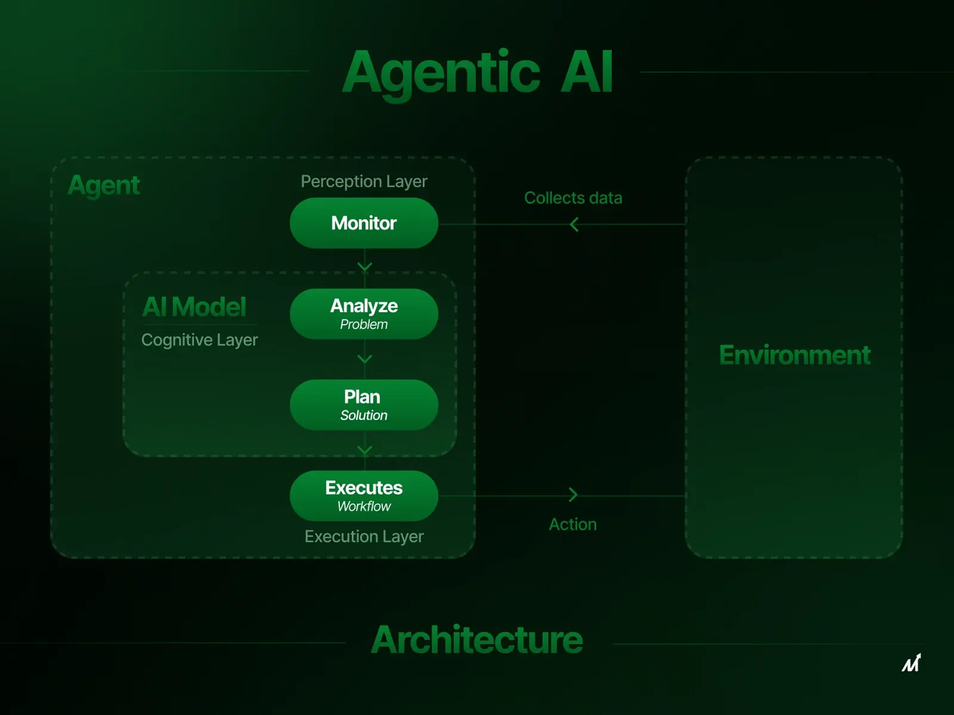

When to Use Agents
Use agents when
1
Problems are dynamic
2
Require reasoning
3
Need tool selection
Examples:
Customer support assistants
Research agents
AI copilots

Slide 10
Memory in Agents
From learning material:
Agents can store conversation history
Enables personalized responses
Example:
“User previously asked about billing → continue context”

Slide 11
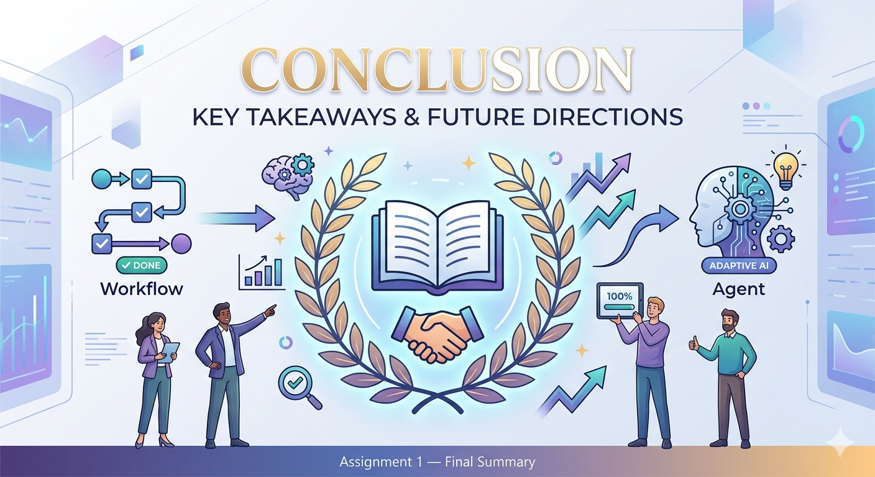
Conclusion
Workflows = predictable, efficient
Agents = flexible, intelligent
Modern AI systems combine both:
Workflow for structure
Agents for decision-making

